Slide 1

Cloud-Native application life-cycle orchestration
Pronounced “captain”
Evaluation and improvements of Open Source Keptn for application life-cycle orchestration
Koumou Jonathan ASSAMAGAN
Mouhamadou KANE

Slide 2
Agenda
What is Keptn?
Objectives
Splunk service & Open-source contribution
Keptn & Bird

Slide 3

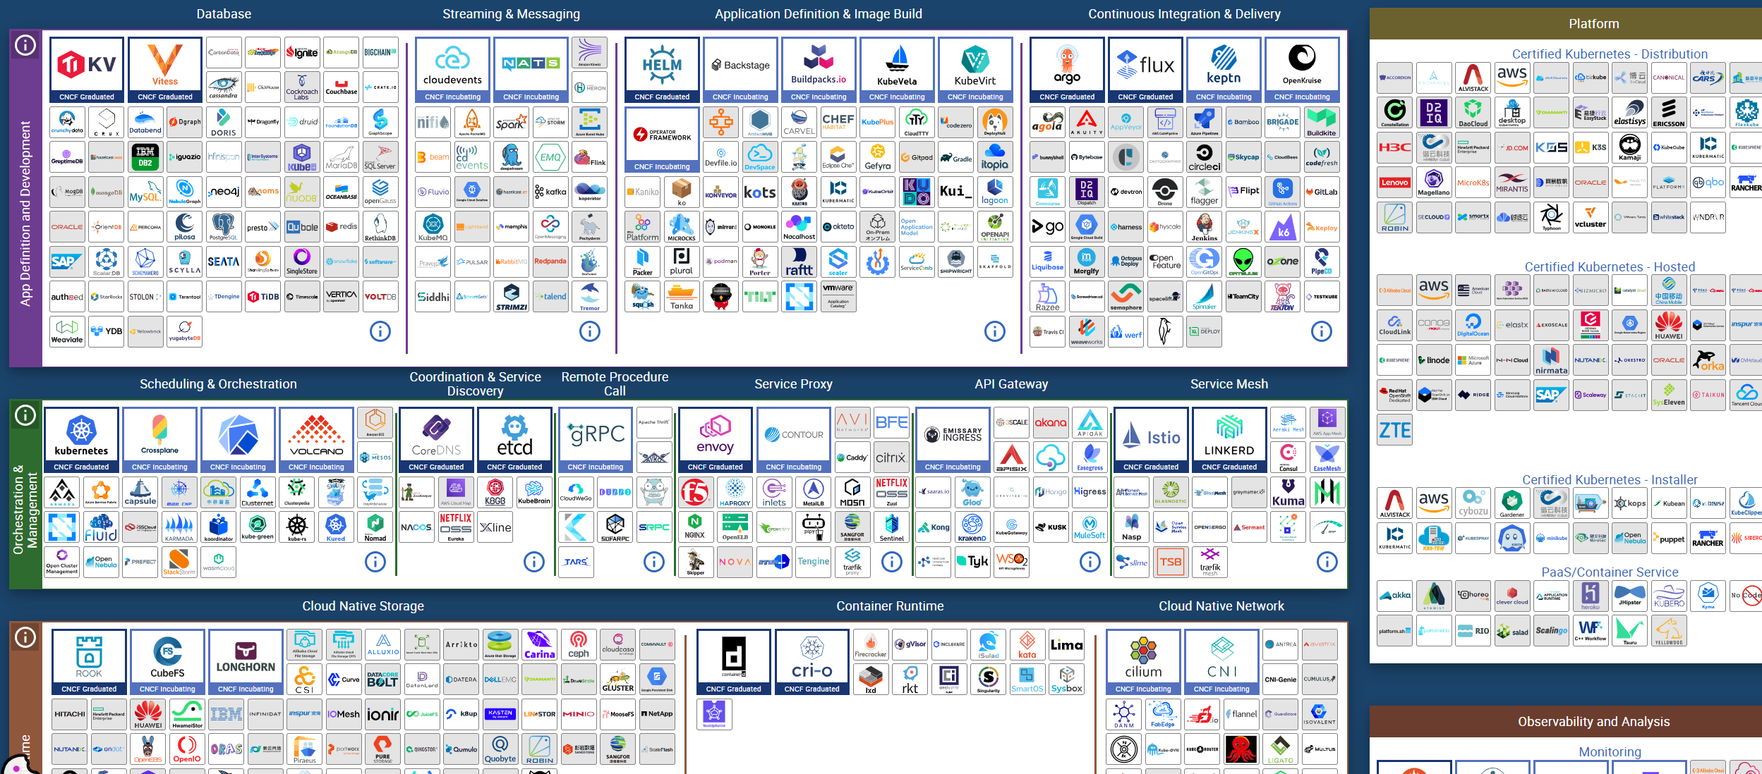
What is keptn?

Slide 4
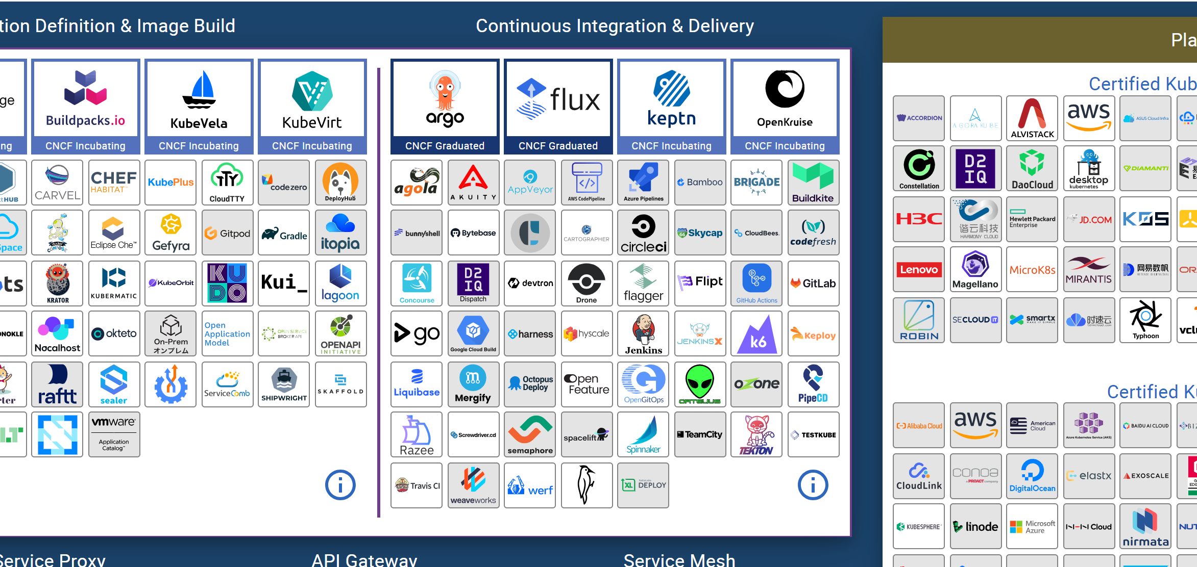
What is keptn?

Slide 5
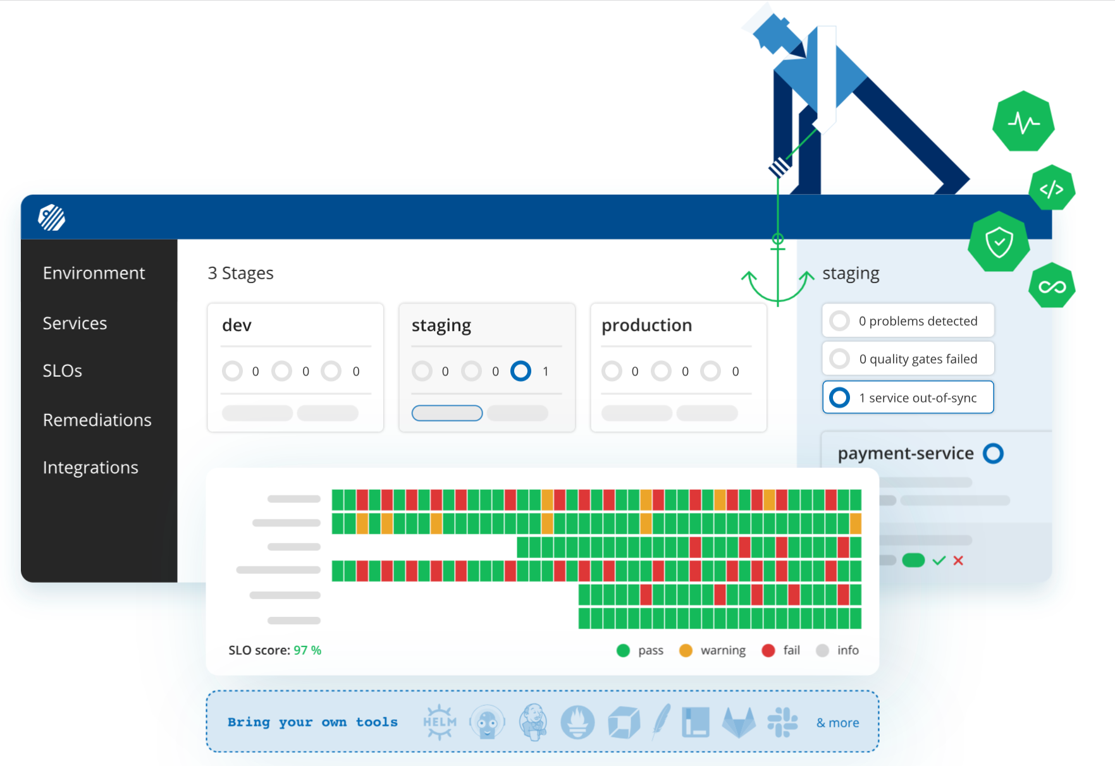

Slide 6
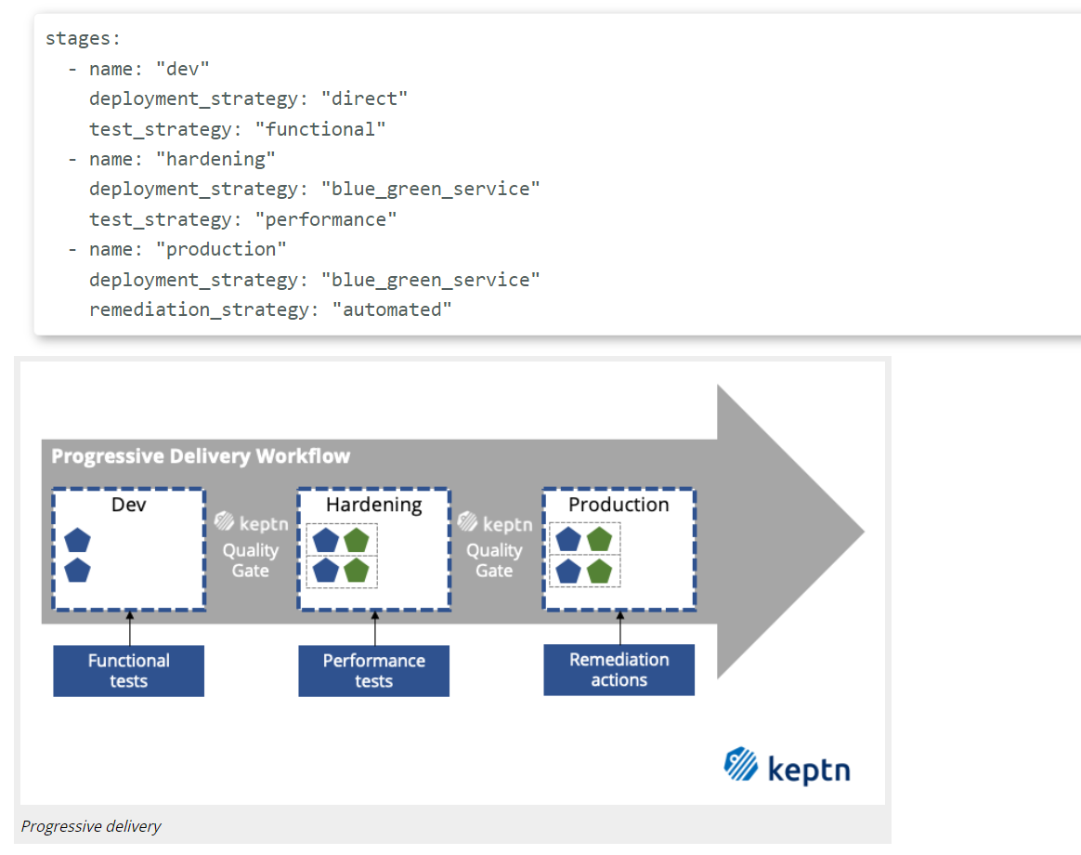
Declarative Multi-Stage Delivery

Slide 7
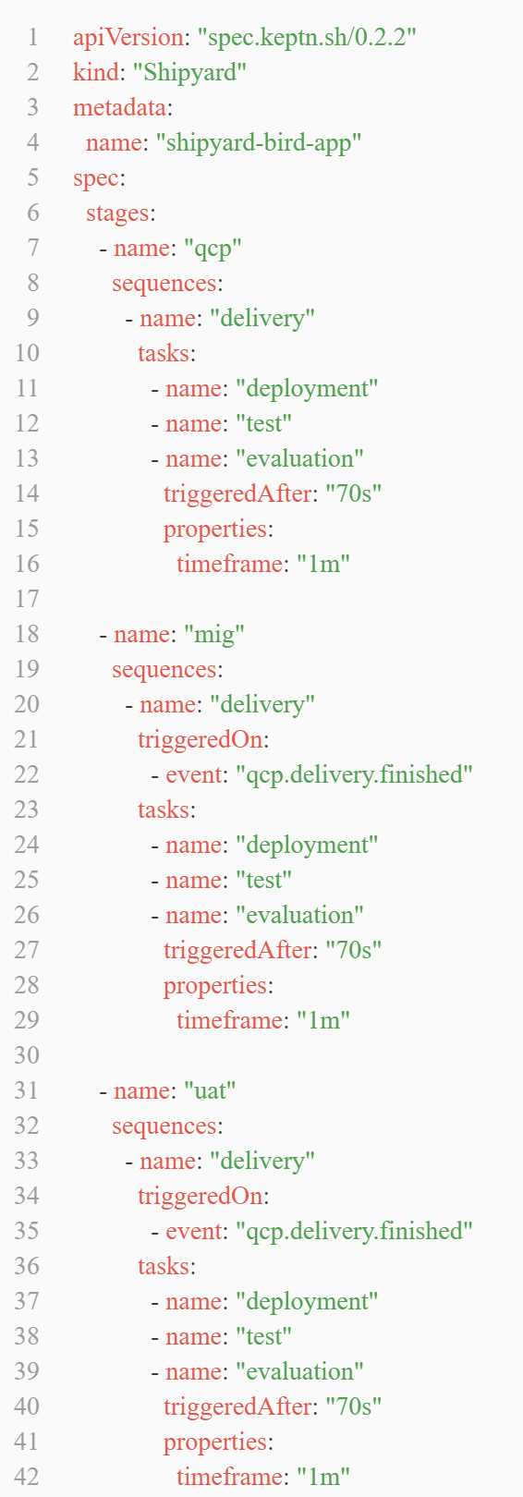
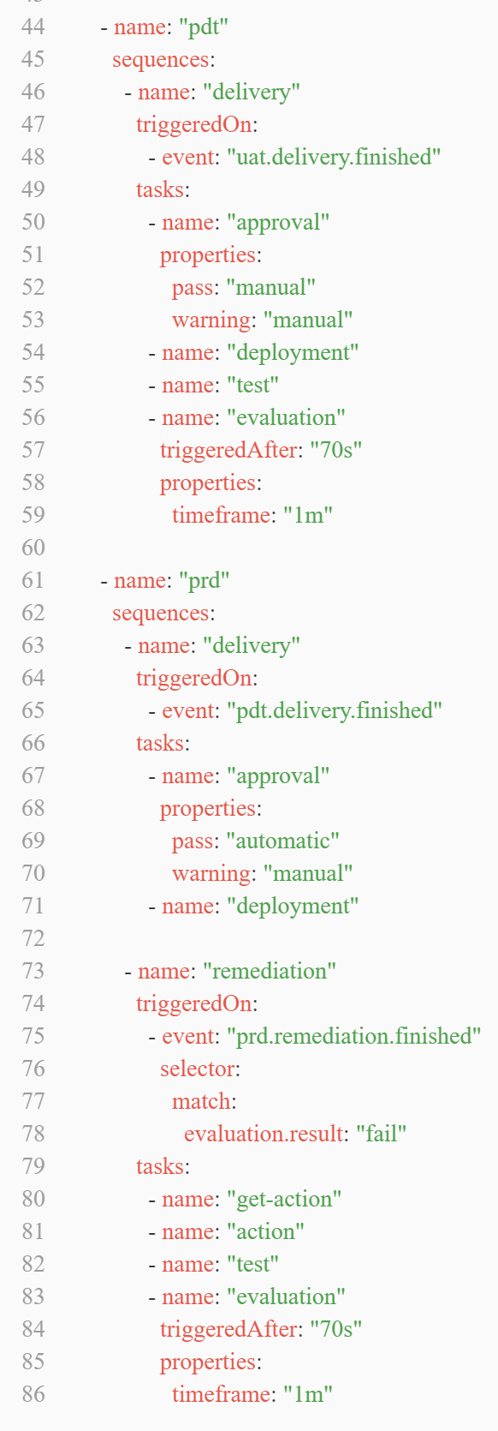
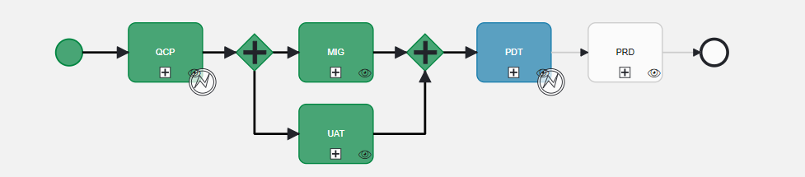
If it was for an OBE?
The shipyard file
Define the workflow for the entire project.

Slide 8
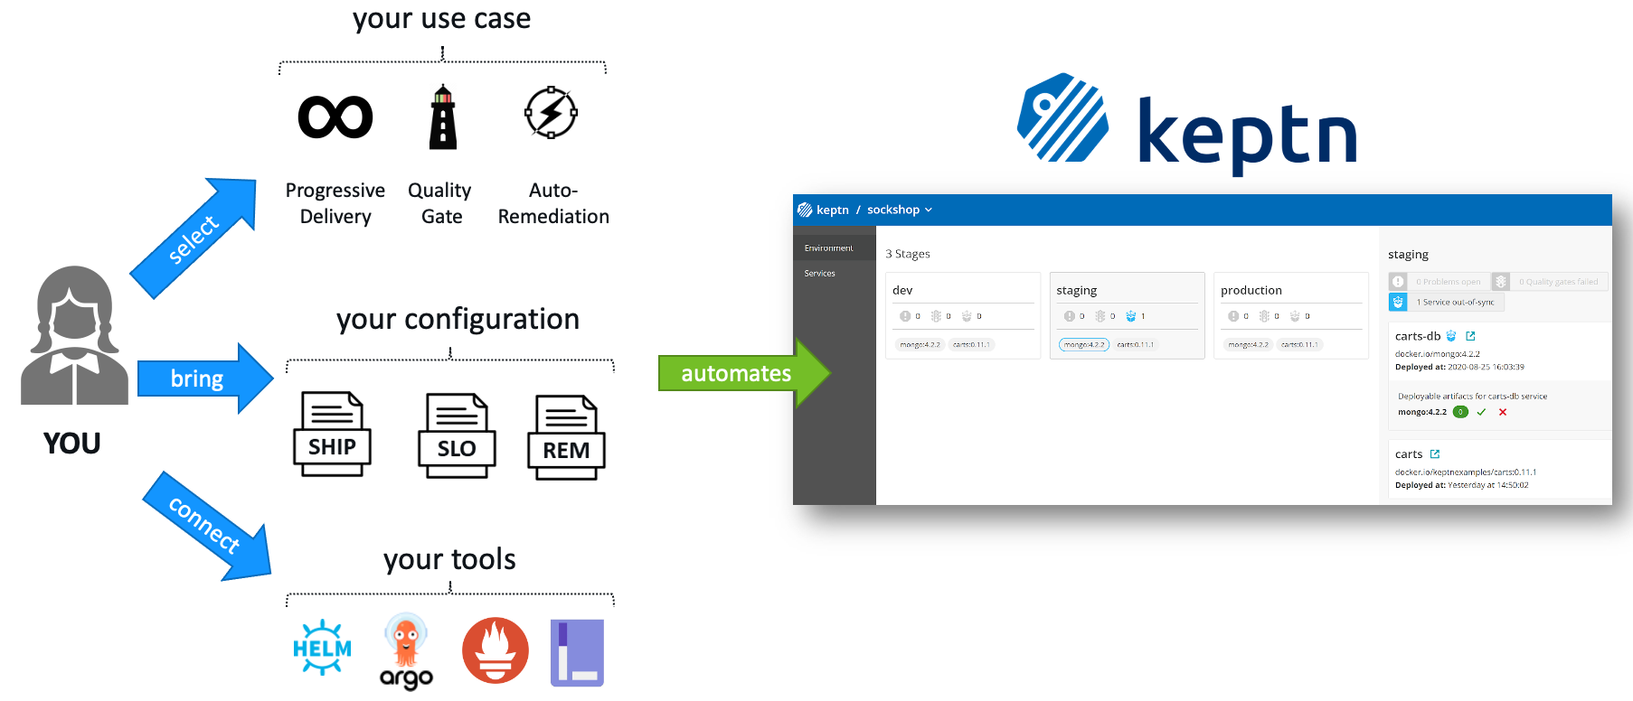
1. What is Keptn…
Source : What is Keptn 2021 ? by Keptn team

Slide 9
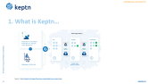
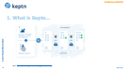
1. What is Keptn…
An open-source project aimed to automate the life-cycle of an application
Scriptless delivery for maintenance : in a declarative approach
Multi-stage delivery + Quality gates
Multi-step Auto-remediation workflows with built-in evaluation.
Event-based automation
Many integrations (keptn-services, tools) to understand and translate cloudEvents
Keptn runs in a Kubernetes cluster and the workflows are based on git
Separation of concern : Declaration and Execution

Slide 10
2. OBJECTIVES :
Stay in touch with the state of the art of Continuous Delivery
Evaluate Keptn : purpose, strengths, weaknesses
- Useful ideas for Bird or continuous delivery in Amadeus
Make Amadeus an actor of the open-source world ✨
- Contribute to the open-source code of Keptn by writing a Keptn SLI-provider for Splunk

Slide 11


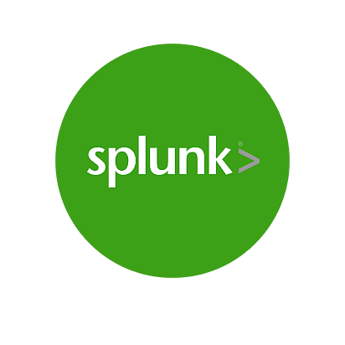



3. Splunk-service and Open-source Contribution :
We worked on :
Lighthouse service
And soon
…
Splunk>
Tool X
Dynatrace
Prometheus
Quality Gates
Notes:
The development of a new Keptn-service (an SLI-provider) for Splunk.
Keptn-service : A Keptn-service is the unit that is executing a task. It can be responsible for executing one or many tasks and it is triggered by an event of a task.
SLI-provider : An SLI-provider is an implementation of a Keptn-service with a dedicated purpose. This type of service is responsible for querying an external data source for SLIs that Keptn then evaluates with SLOs. To configure a query for an indicator, Keptn provides the concept of an SLI configuration.

Slide 12
3. Splunk-service and Open-source Contribution :
Quality Gates
A complete Splunk Service in GO :
Subscribes to two (2) keptn cloud events :
configure-monitoring.triggered events
get-sli.triggered events
Handles the get-sli event in order to evaluate the application
Handles the configure monitoring event by setting up the alerts
Polls for triggered alerts in Splunk in order to start the remediation process in keptn
Lighthouse service
Splunk Service
Splunk>

Slide 13
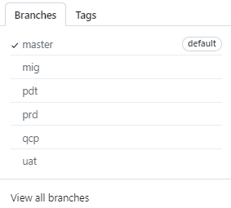
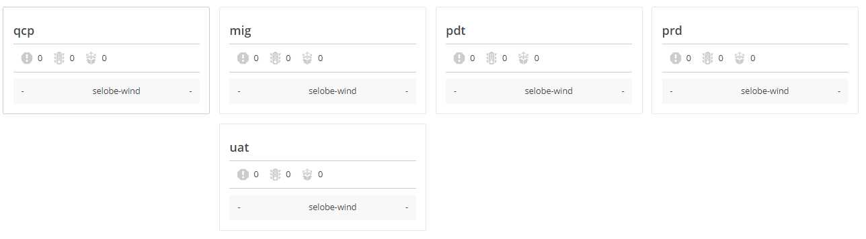
Setup the project

Slide 14
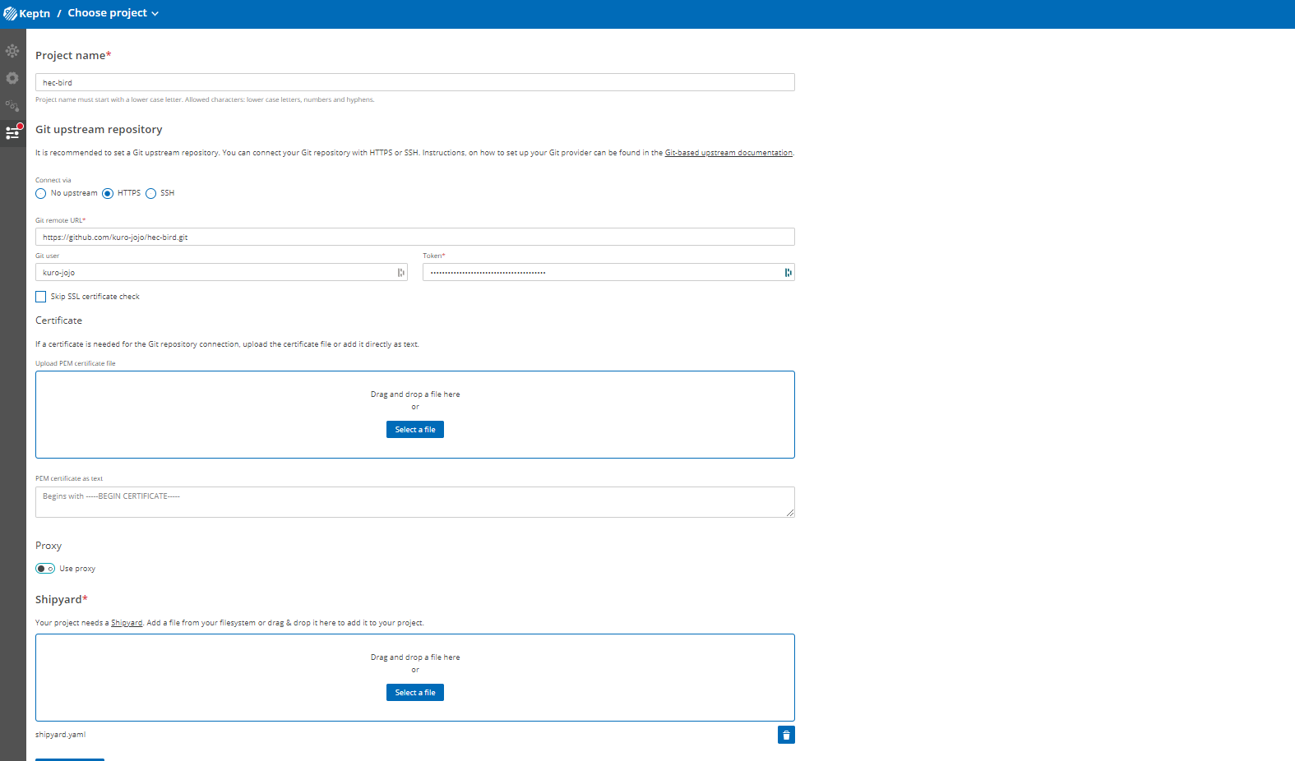
Setup the project

Slide 15
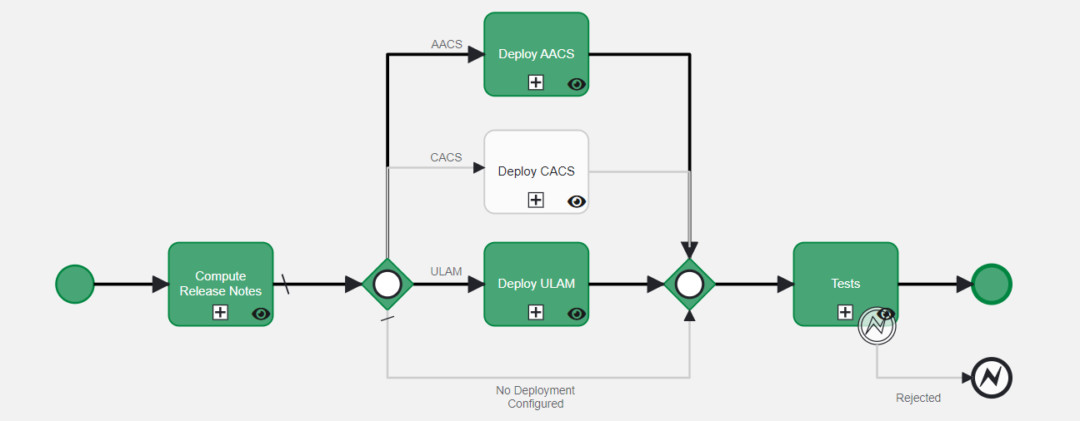
Setup the project

Slide 16
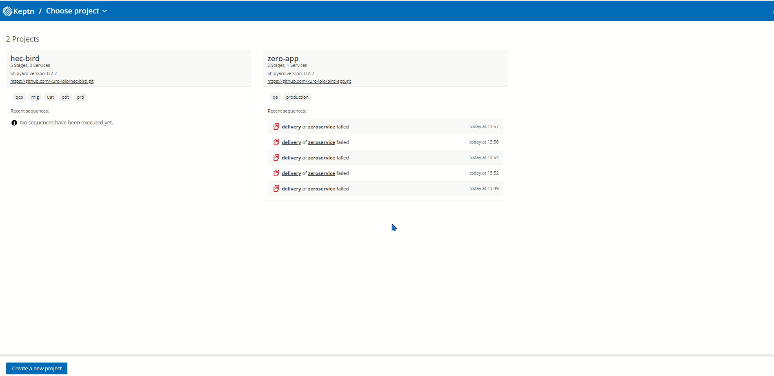
Create a new service

Slide 17
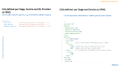
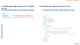
Add the resources
01
SLIs and SLOs for each stage
Job-executor service configuration
The helm chart of the application
Add all other files (tests files, service config,…)

Slide 18
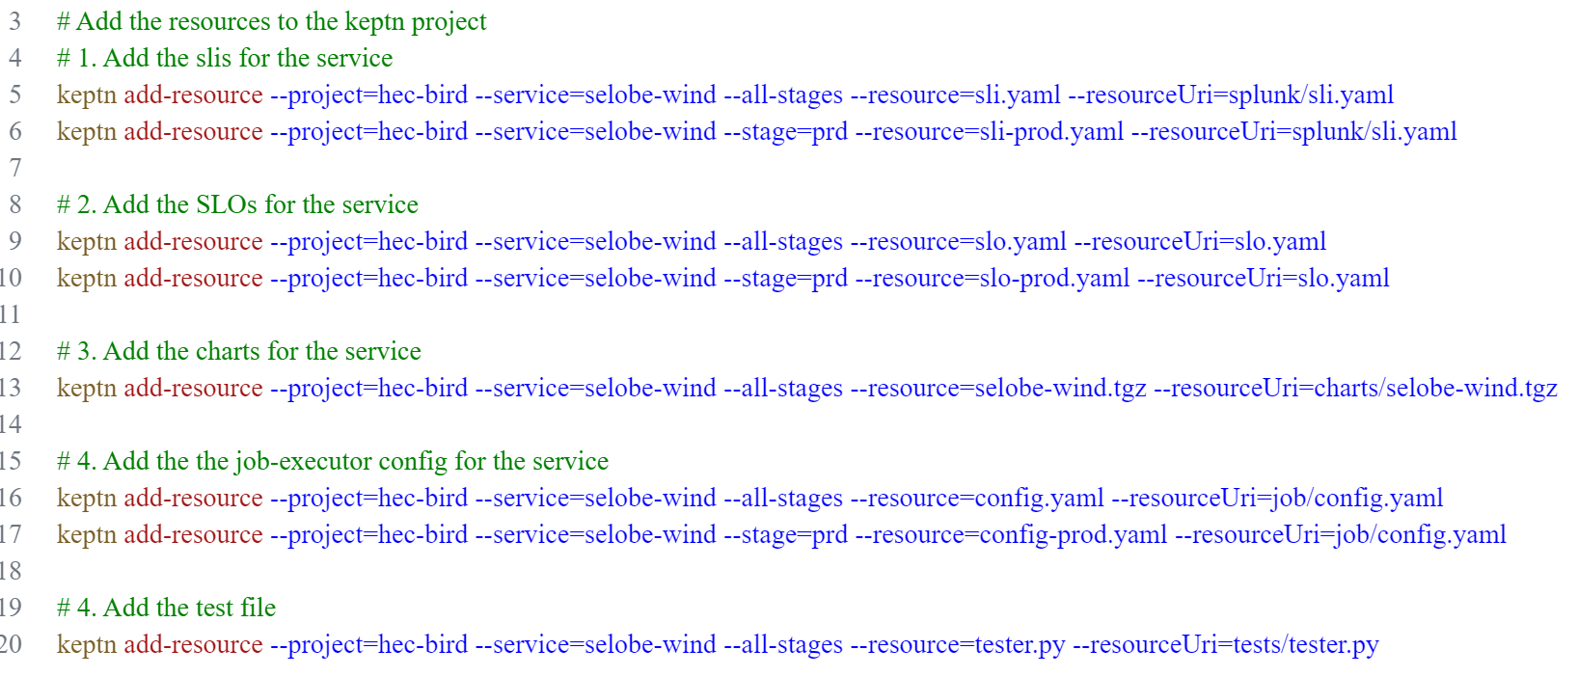
Add the resources
keptn add-resource --project=PROJECT --stage=STAGE --service=SERVICE --resource=FILEPATH_LOCAL --resourceUri=FILEPATH_GIT

Slide 19
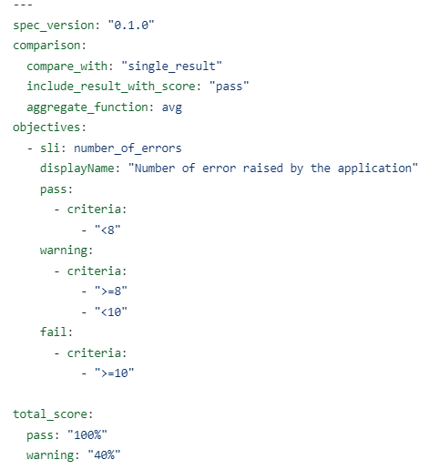
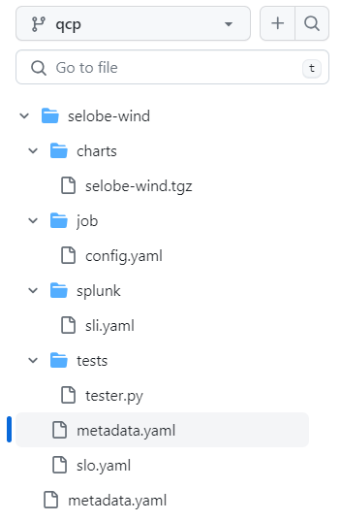
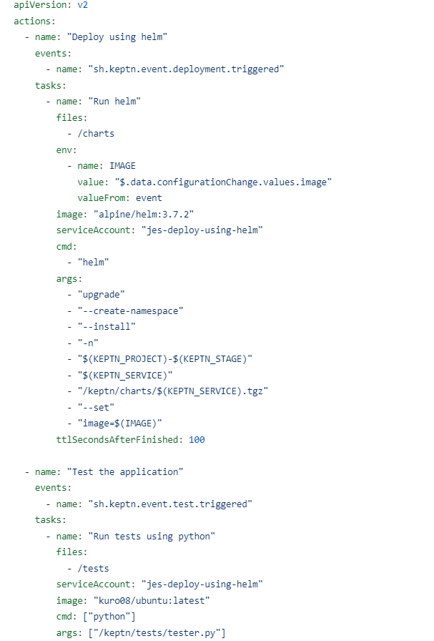
Add the resources
sli.yaml
slo.yaml
config.yaml

Slide 20
Add the resources
01
SLIs and SLOs for each stage
Job-executor configuration
The helm chart of the service
Add all other files (tests files, service config,…)
02
Install the provider (splunk-provider)

Slide 21
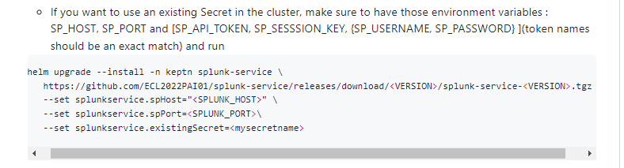
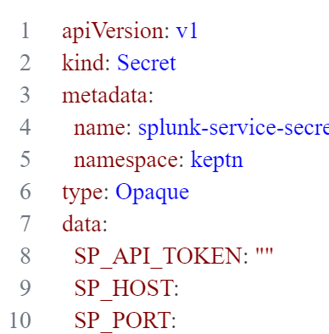
Install the Splunk service
Documentation of the splunk-service
helm upgrade --install -n keptn splunk-service \
https://github.com/ECL2022PAI01/splunk-service/releases/download/0.3.3/splunk-service-0.3.3.tgz \
--set splunkservice.existingSecret=splunk-service-secret
Secret containing splunk instance creds

Slide 22
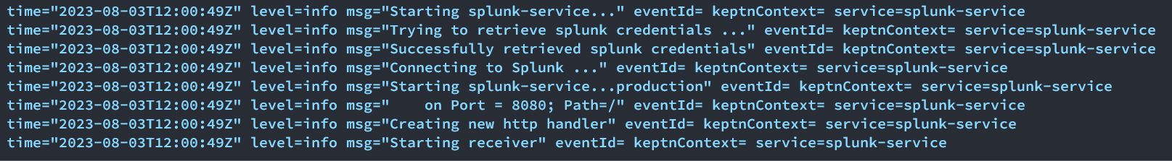
Install the Splunk service
The distributor
Receives events from keptn and dispatch them to the service
The splunk-service
The service which performs actions depending on the received event

Slide 23
Add the resources
01
SLIs and SLOs for each stage
Job-executor configuration
The helm chart of the service
Add all other files (tests files, service config,…)
02
Install the provider (splunk-sli-provider)
03
Configure keptn to use the wanted provider

Slide 24
Configure the monitoring tool
keptn configure monitoring splunk --project=hec-bird --service=selobe-wind
{
"contenttype": "application/json",
"data": {
"project": "hec-bird",
"service": "selobe-wind",
"type": "splunk"
},
"source": "https://github.com/keptn/keptn/cli#configuremonitoring",
"specversion": "1.0",
"type": "sh.keptn.event.configure-monitoring.triggered"
}

Slide 25




A word on the remediation
v2 deployed
in prod
Upgrade to newer version
We need to do something
Stable v1 release
Rollback to v1

Slide 26
A word on the remediation
v2 deployed
in prod
Upgrade to newer version
We need to do something
Stable v1 release
Rollback to v1

Slide 28
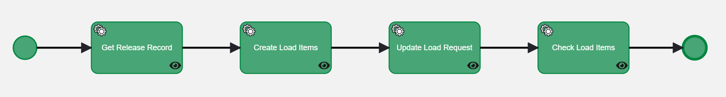
3. KEPTN and BIRD : Workflow
Tool dependency in the workflow
Service tasks in the workflow that are specific to Win@pproach
Same dependencies for the other tools like Jenkins for the tests for example.
Not able to use other tools for this workflow so it affects its reusability

Slide 29
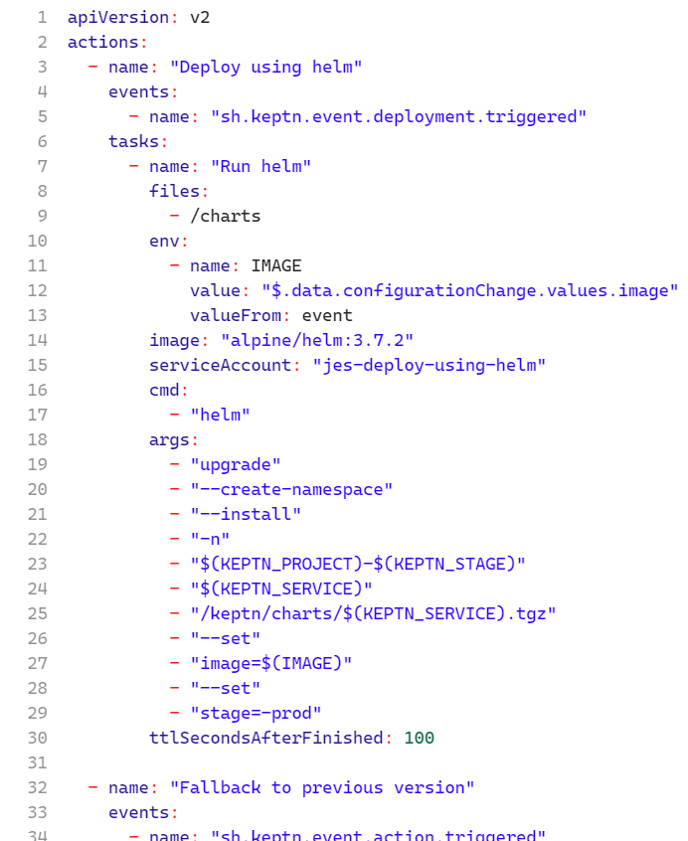
3. KEPTN and BIRD : Workflow
Execution Plane : keptn services
Performed actions and tool used
Control Plane :
Workflow doesn’t specify tools
Job-Executor-Service
Other Keptn-services :
Prometheus-service
Datadog-service
Splunk-SLI-Provider
….
Shipyard file
Job executor config file

Slide 30
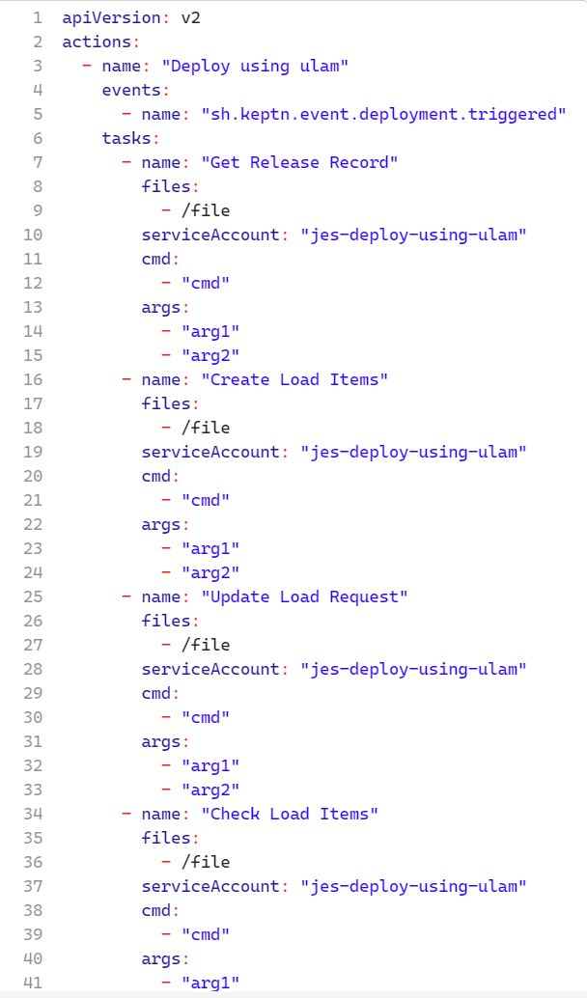
3. KEPTN and BIRD : Workflow
Here the different service tasks are defined in a
configuration file separated from the
workflow configuration file.
+ The same workflow can be reused for multiple deployments using different tools.
+ BIRD workflow knows Win@pproach but KEPTN workflow doesn’t know Win@pproach. Less coupling !!!

Slide 31
3. KEPTN and BIRD : Event Driven

Slide 32
3. KEPTN and BIRD : Auto-Remediation

Slide 33
5. Demo

Slide 34
Thanks !!

Slide 35
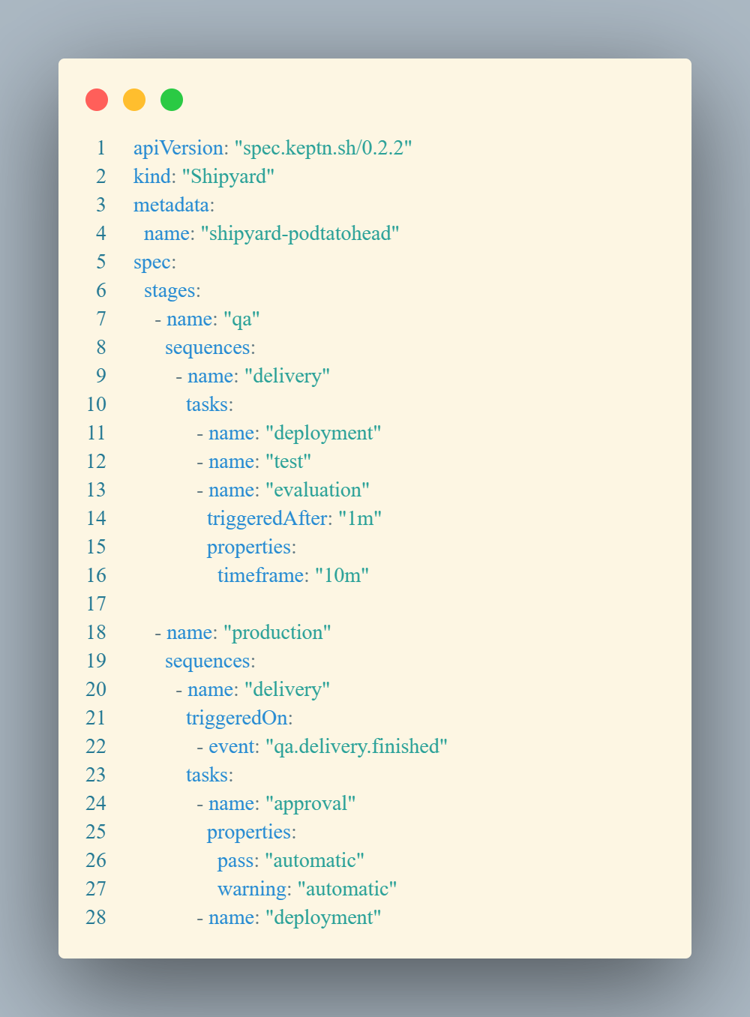

Slide 36
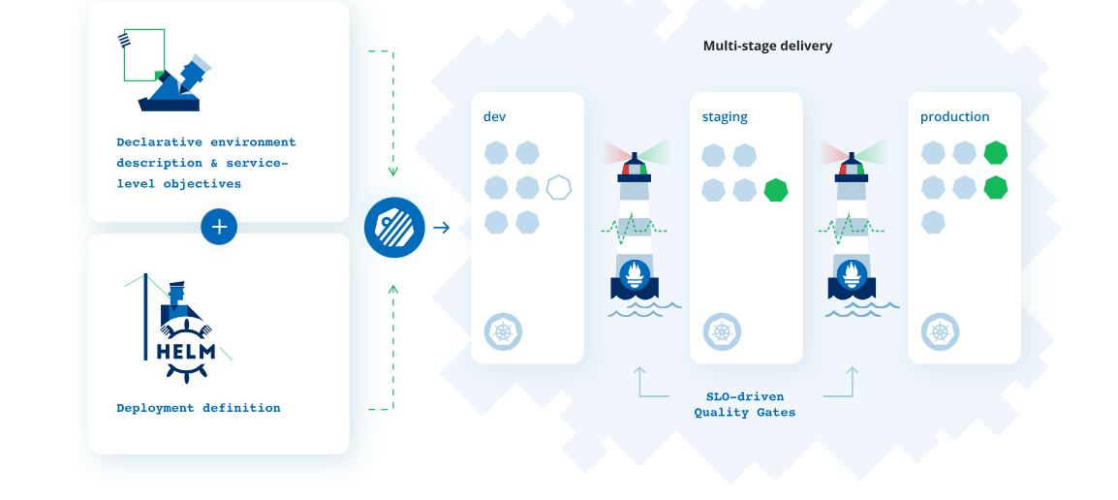
1. What is Keptn…
Source : https://keptn.sh/images/home/use-cases/graphic-use-case-02.svg

Slide 37
1. and why Keptn ?
Resolve time consuming problems :
maintaining pipelines
manual tasks
manual remediation
A sharable declarative workflow definition
Event based automation
Auto remediation

Slide 38
4. Splunk-service and Open-source Contribution :
We worked on :
Splunk SLI-Provider in GO:
Initially using the splunk sdk in Python. Now we have created a “splunk sdk” in GO.
Added unit tests
Cleaned the code
Removed hard coded sensitive elements
Tested a complete working pipeline
Created a usable release (v0.1.0)
Quality Gates
Lighthouse service
Splunk SLI-provider
Splunk>
Notes:
Initially using the splunk sdk in Python. Now we have created a “splunk sdk” in GO.
Added unit tests
Cleaned the code
Removed hard coded sensitive elements
Tested a complete working pipeline
Created a usable release (v0.1.0)

Slide 39
5. Demo
Quality Gates
Lighthouse service
Study how the remediation is implemented in Prometheus-service in order to use it for the Splunk-service.
A new Keptn service that handle a get-sli and configure-monitoring events and forward them to multiple Sli-providers.
Saad Service
Prometheus Service
Splunk Service
X Service
Tool X
Prometheus
Splunk>

Slide 40
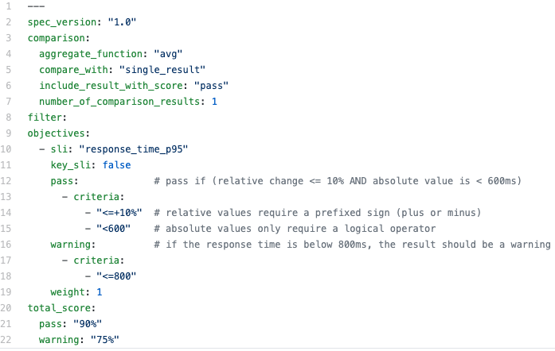
SLIs defined per Stage, Service and SLI Provider as YAML SLI Provider specific queries, e.g: Prometheus Metrics Query
SLOs defined per Stage and Service as YAML
List of objectives with fixed or relative pass & warn criteria
indicators:
error_rate: "sum(rate(http_requests_total{job=’...’)"
count_dbcalls: "sum(rate(http_requests_total{job=’...’)"
response_time_p95: "histogram_quantile(0.95, sum(rate(“...”)))”

